Slide 1

Correspondence Analysis: Smart City Priority Development Survey
Notes:
Good evening, I’m Jenna Wallace.

Slide 2
The Business Challenge
Can we identify patterns and relationships between resident demographics and how they feel about how technology should use to solve problems in our communities?
Notes:
In 2022, the City of San Antonio Office of Innovation launched the Smart Cities Priority Development survey.
“Smart cities” refers to how communities use technology in innovative ways to solve problems.
The survey will help the Office of Innovation better understand resident priorities and concerns when it comes to using data, technology, and innovation for public services.
The goal of this analysis is to identify any patterns and relationships between different variables such as resident demographics and priorities.

Slide 3
Questions Considered for Analysis
Demographic Questions
Opinion Questions
Age
Gender
Race
Council District
When it comes to using the City of San Antonio's services online, which aspect is most important to you?
Please choose the public services you would like the City of San Antonio to prioritize. (Choose your top 3)
How can using technology help you lead a more healthy, comfortable, and happy life in San Antonio? (Pick your top 5)
Notes:
The survey asked several demographic questions, including age, gender, race and council district.
There were also a number of questions regarding what public services should be prioritized, how technology can improve quality of life, and concerns residents had about using online services.
All of responses were categorical choices.
For this analysis, I chose to explore if there was a relationship between age and what is important when using City services online.

Slide 4
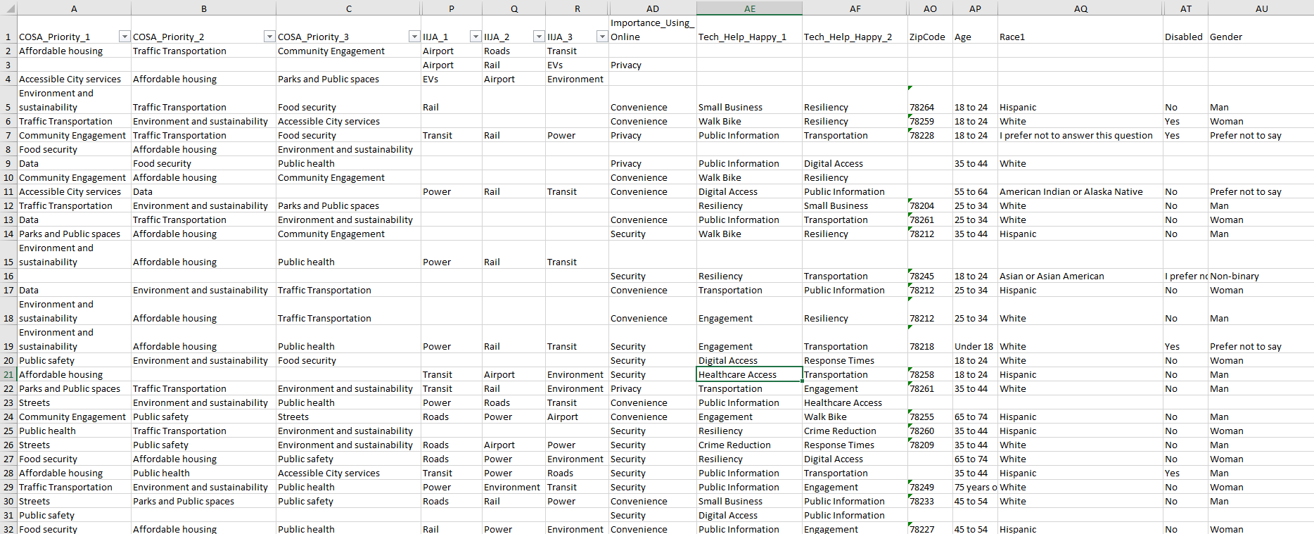
Cleaned Data
1846 responses
Notes:
There were 1846 responses to the survey.
Here is a sample of the cleaned data.
As you can see, there is a lot of missing responses. This is very common with surveys, since respondents don’t always answer questions if they aren’t required.

Slide 5
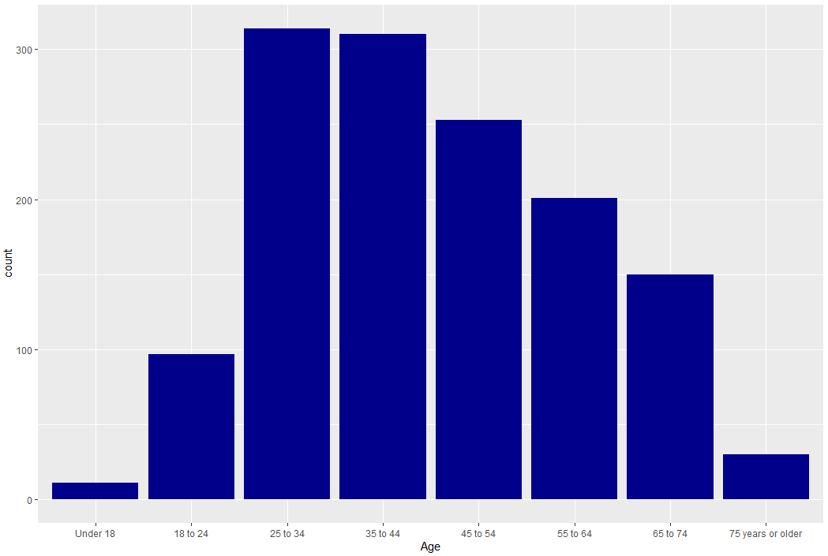
What is your age?
1366 responses
Age Ranges
Under 18
18 to 24
25 to 34
35 to 44
45 to 54
55 to 64
65 to 74
75 years or older
Notes:
Respondents were asked to select their age range from eight levels.
There were 1366 responses
Responses followed a relatively normal distribution.

Slide 6
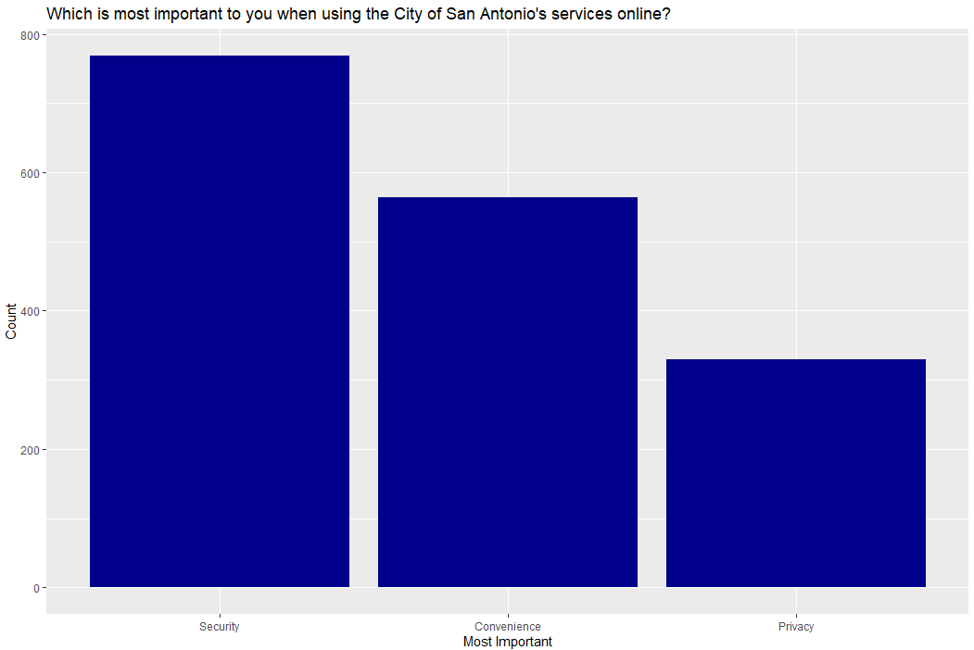
When it comes to using the City of San Antonio's services online, which is most important to you?
Privacy | How information is collected about you while using the internet or technology
Convenience | The ability to access online resources easily
Security | Being protected against online threats such as stolen information or viruses
1662 responses
Notes:
Respondents were asked to choose if privacy, convenience or security was most important when using City services online.
Out of the 1662 responses to this question, security was selected most, followed by convenience, and then privacy.

Slide 7
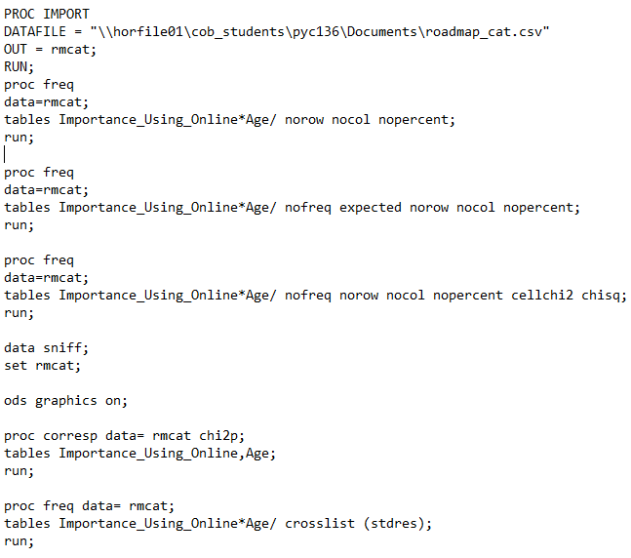
Correspondence Analysis
Multivariate graphical technique designed to explore relationships between nominal variables
Assumptions:
Nominal variables
No distribution normality assumed
Independence of categories
Sample size should be sufficient for each category of the variables
Notes:
Since this survey collected data on multiple categorical variables, correspondence analysis was a good choice for examining relative relationships between my two variables Age and Importance_Using_Online.
Like any statistical method, correspondence analysis relies on certain assumptions to be valid.
- First, the variables must be nominal or categorical
- The categories in each variable should be independent of each other.
- The sample size should be sufficient for each category of the variables.
- And for this method, there is no assumption of distribution normality
I ran the correspondence analysis in SAS and in R, because SAS outputs better tables, but R produces better plots.

Slide 8

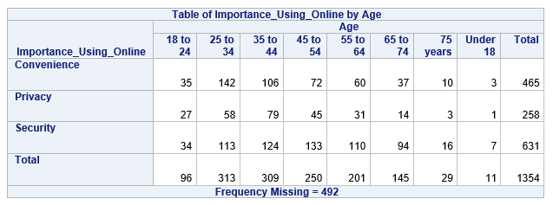

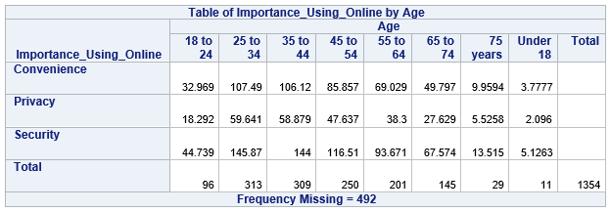
Observed vs Expected
Notes:
Here are the contingency tables for observed and expected.
You’ll notice the total is 1354, which was the number of observations where respondents answered both the Age and the Importance_Using_Online question. Correspondence analysis uses listwise deletion – that is, an observation is dropped from the analysis if it has a missing value in at least one of the specified variables.

Slide 9

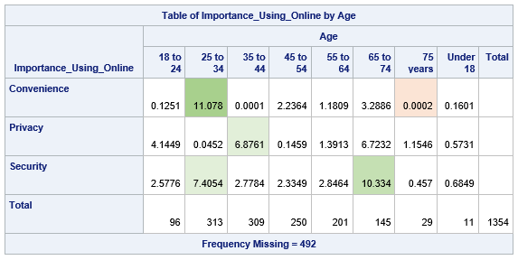
Chi-Square Contribution
Notes:
Here is the table showing the chi square contribution for each cell in the contingency table.
The cell that contributes most to the total chi square is Convenience for 25-34 year olds at 11.078.
Other cells that have high contribution is 65 to 74 and Security, 25-34 and Security, and 35 to 44 and privacy.
The cell that contributes the least is Convenience for 75 year olds, which is very low at 0.0002

Slide 10
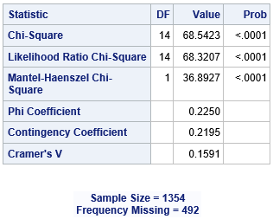
Chi-Square
Notes:
Looking at the Chi Square statistic, there are 14 degrees of freedom. The p-value for Chi-square is less than .0001, so we can reject the null hypothesis and accept the alternative hypothesis that there is a relationship between age and what is important when accessing online services.

Slide 11
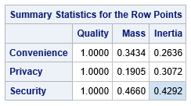
Summary Statistics for Row Points
Notes:
In looking at mass, inertia and quality, all row points have high quality.
Security has both the highest mass and highest inertia, which means it contribute most to explaining the variation in the data.

Slide 12
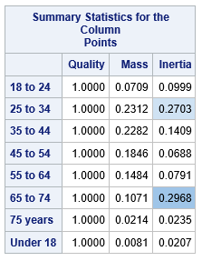
Summary Statistics for Column Points
Notes:
We can see that all column points also have high quality.
Group 25-34 has the highest mass.
Age group 65-74 has the highest inertia, followed closely by 25-34

Slide 13
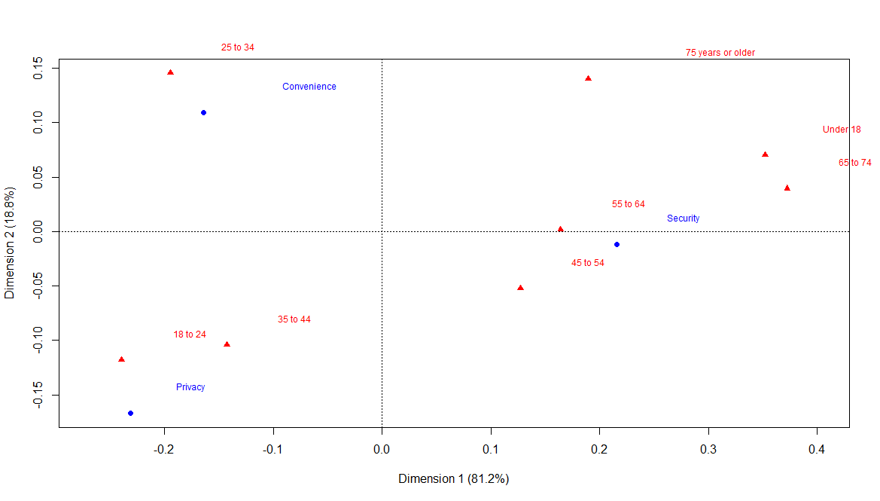
Correspondence Analysis Plot
Notes:
Here is the Correspondence Analysis Plot. Age is shown in red, Importance_Using_Online is in blue.
Dimension 1 explains 81.2% of the variance and Dimension 2 explains 18.8% of the variance.

Slide 14
Correspondence Analysis Plot with highlights
Notes:
In terms of age, we can say that age 25-34 is highly differentiated because it is far from the origin.
Similarly, convenience is a highly discriminating attribute.
We also know that if there is a small angle connecting a row and column label to the origin, they are probably associated.
In this case, there is probably a strong relationship between convenience and age 25-34.

Slide 15
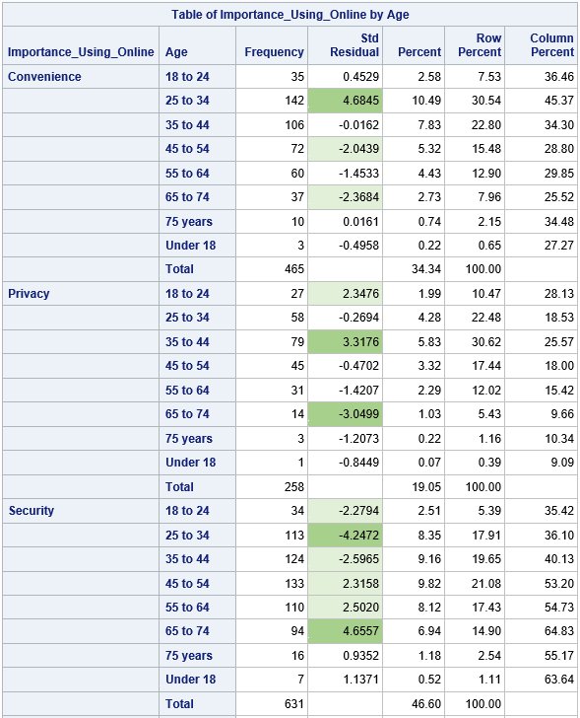
Table of Importance
Notes:
With the plot, we’re just eyeballing what we think the relationship is.
But we can use standard residuals to determine if a cell is a source of significance.
As we learned in class, any cell with an adjusted residual of 2.0 or more can be considered a source for the significant result.
If there are a lot of cells, an adjusted residual of 3.0 or more can be used.
Here, the light green shows the residuals higher than 2 and dark green shows the residuals of 3 or more.
We can see that Convenience for 25 to 34 has residuals of 4.68, which is a strong source for the significant result. We saw this relationship in the plot.
Security and the 65-74 age group is also a strong source of the significant result, as is security and 25-34 group, both larger than 4.
Note that Security is a source of at least moderate significance for most age groups.
Where these numbers are positive, it shows that there are more people observed here than expected
Where these numbers are negative, it means there are fewer people observed than expected

Slide 16
Conclusion
Convenience and Age 25-34
Security and Age 65-74
Privacy and Age 35-44
Security and Age 25-34
Privacy and Age 65-74
Notes:
So using the chi square contribution table, the correspondence plot, and the standard residuals, we see some patterns and can draw the conclusion that there are strong to moderate relationships between age and what people think is important when using online services.
This can help us determine what messaging we may want to use when promoting City online services. We could emphasize convenience for the younger user. We could reassure our older residents that their transactions would be safe and secure. And we could clearly indicate for middle aged residents what personal data is collected and how it is used.
Since correspondence analysis has been effective for comparing these variables, we can do further analysis on the other variables, such as seeing if there is a relationship between gender and Priorities, or Race and how technology can improve quality of life.

Slide 17

Thank you!
Notes:
In conclusion, correspondence analysis can help us identify which priorities are most closely associated with certain demographic groups, allowing policymakers and city planners to make informed decisions about how to use technology to meet the needs of their residents.
Thank you!

